Slide 1

Introduction of HKU-PGSA
Runzhi ZHANG
President, Executive Committee 2020-2021
Email: u3535494@hku.hk, pgsa@hku.hk
1 July 2020

Slide 2
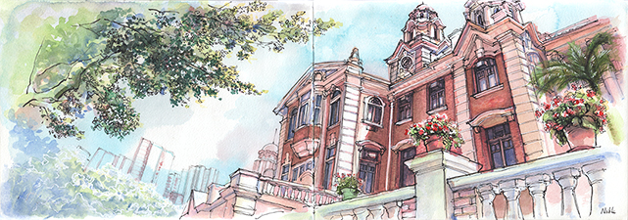
The University of Hong Kong 香港大學
Founded in 1911
10 Faculties
Undergraduates – 17,106
Postgraduates – 12,685
Taught Postgraduate (9,813)
Research Postgraduate (2,872)
MPhil/PhD (Session 2018-2019)
World rank #22, Asia rank #4 (QS 2021)

Slide 3
Quick Stats (2018-2019)
 |  | Male | Female | All | Gender Ratio | % International
 |  | 男 | 女 | 總計 | (Male : Female) | (Based on Nationality)
 |  |  |  |  | 男女比例 | 國際化百分比
 |  |  |  |  | （男：女） | （以國籍釐定）
Student Admission* | Taught Postgraduate | 2,212 | 3,583 | 5,795 | 0.62 : 1 | 50.20%
新入學學生人數 * | 修課式研究生
(2018 / 2019) | Research Postgraduate | 402 | 389 | 791 | 1.03 : 1 | 79.50%
 | 研究式研究生
 | All | 2,614 | 3,972 | 6,586 | 0.67 : 1 | 42.40%
 | 總計
Student Enrollment* | Taught Postgraduate | 4,138 | 5,675 | 9,813 | 0.73 : 1 | 42.10%
學生就讀人數 * | 修課式研究生
(2018 / 2019) | Research Postgraduate | 1,483 | 1,389 | 2,872 | 1.07 : 1 | 78.10%
 | 研究式研究生
 | All | 5,621 | 7,064 | 12,685 | 0.80 : 1 | 34.60%
 | 總計

Slide 4
About PGSA
Founded in 1993, oldest registered student association run by the postgraduate students in HKU;
Independent unit and autonomous body for postgraduate students’ benefits and rights;
Aims to enhance postgraduate life at HKU by encouraging students to take active interest in their welfare by participating in various academic, social and professional events;
Build a strong community among the postgraduate students;
Lifetime membership.

Slide 5

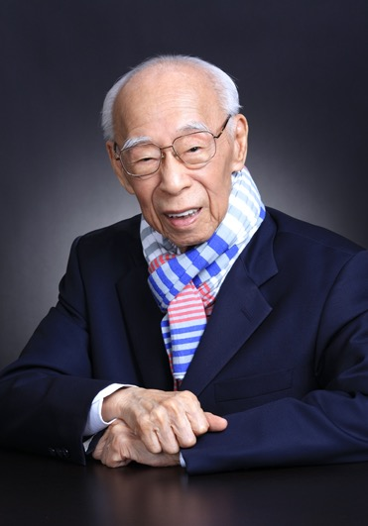
明德 Virtus
The ability to manifest virtue
格物 Sapientia
The ability to investigate things
致知
The ability to reach toward the knowledge and understanding
Jao Tsung-I (1917-2018)

Slide 6
How PGSA works?
PGSA
General Meeting
General Pooling
Council
Executive Committee

Slide 7
Executive Committee
President
University Affairs
Vice President (Internal)
Vice President (Executive)
Vice President (External)
General Secretary
Treasurer
Academic Development
Membership & Alumni Affairs
International Liaison
Archive
Student Welfare
Information & Technology
Career Development
Recreational & Cultural Development
Publication
Social Programme

Slide 8
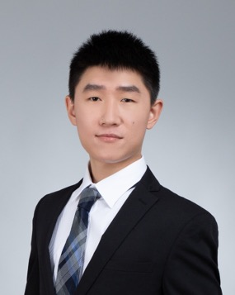
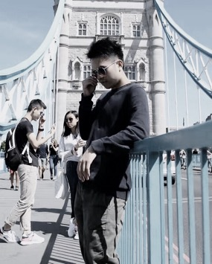
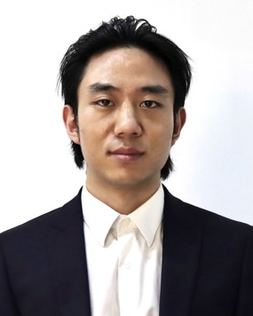
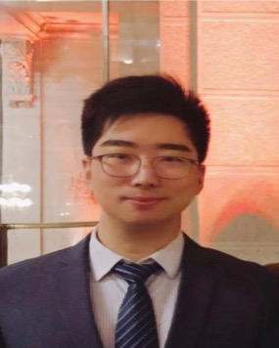

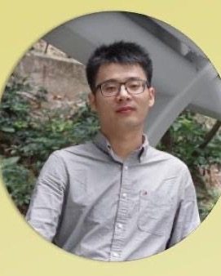
Presidium 主席團
President
Mr. Runzhi ZHANG
Vice-President (Executive)
Mr. Jiajun WEN
Vice-President (Internal)
Mr. Rui QI
Acting
Vice-President (External)
Mr. Zechu FENG
Treasurer
Ms. Mengfei YUAN
General Secretary
Mr. Di WU

Slide 9
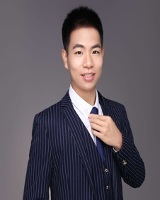
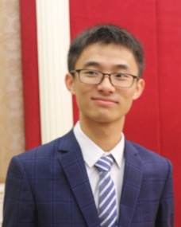
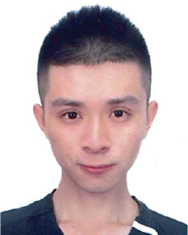
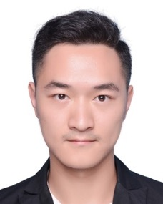
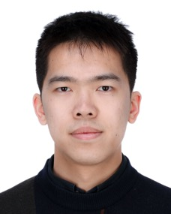
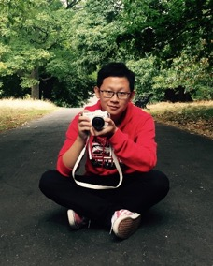
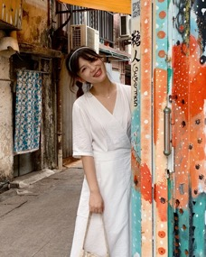
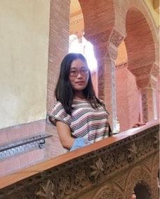
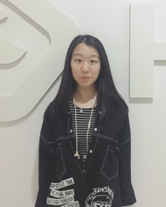
Secretaries of Offices 部長
Membership &
Alumni Affairs
Mr. Chenshu SONG
Information & Technology
Mr. Yijie WU
Publication
Mr. David Cheng Chi Chiu
University Affairs
Mr. Dan RAN
Academic Development
Mr. Tengbo YANG
Career Development
Mr. Andong WANG
Recreational & Cultural Development
Mr. Tangsenyi SHI
International Liaison
Ms. Yuchen TANG
Archive
Ms. Caroline Ting ZHOU
Social Programme
Ms. Ruiyan GAO

Slide 10
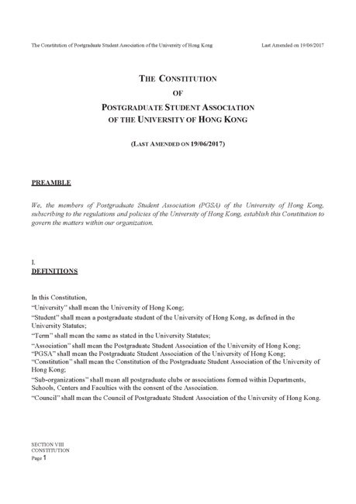
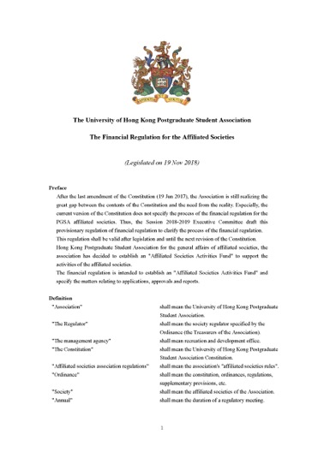
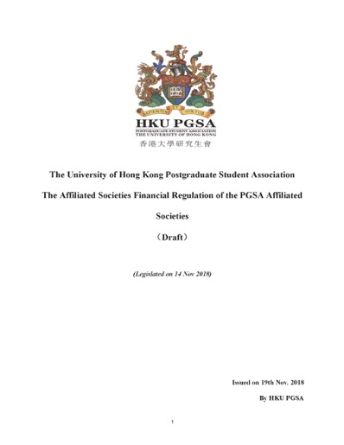
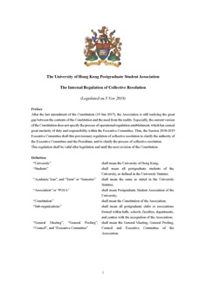
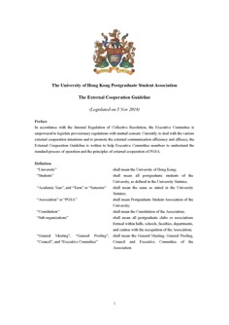
Constitution and Regulation 章程 與 規定

Slide 11

Finance 研會財政
Funding sources
Full Membership Fee
Sponsorship
University Funding
CEDARS Virtual Budget
GS Academic Events Fund
Expenses
Student Welfare
Activities Cost
Daily Operation

Slide 12





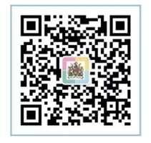
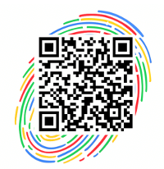
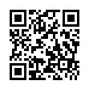
Publication Means 宣傳管道
Bulk Email System
120 posts from Aug 2019 to July 2020
WeChat Public Account
129 posts from Aug 2019 to July 2020, 11541 followers
YouTube
16.7k subscribers, 香港大學研究生會HKU-PGSA
Facebook
Weibo
WeChat Groups
WeChat
Weibo
Facebook

Slide 13
Full Membership
The number of verified Full Member has been increasing during 2015 to 2019.
The membership system is being improved for more friendly registration and verification.
Total number of Full Member
Around 1000 (as at 1 July 2020)

Slide 14
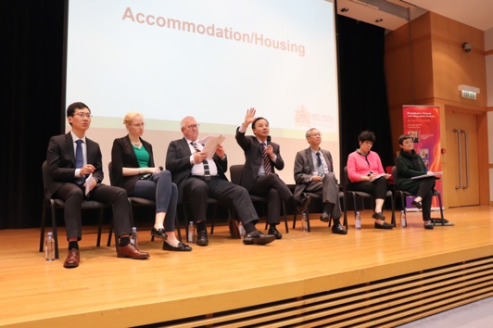
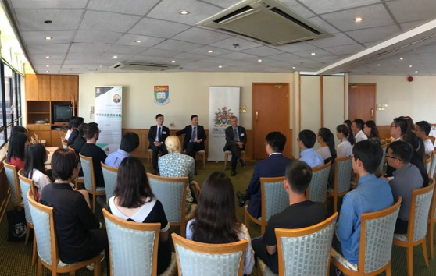
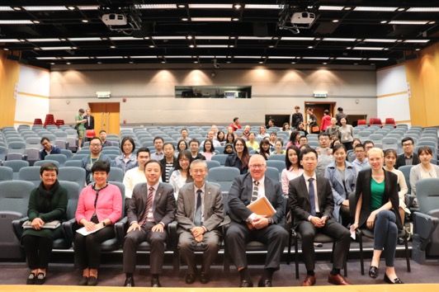
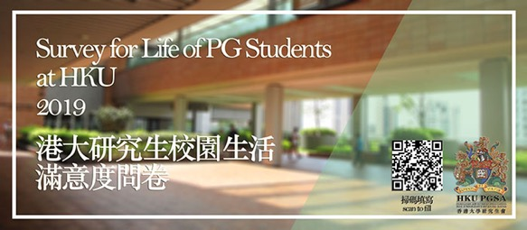
University Affairs 大學事務
University Council and Senate
University Governance
Nomination to 10 Committees
(Campus Life, Careers & Placement, Catering, eLearning, Equal Opportunity, Halls, Health, Safety & Well-Being, Library, Personal Development & Counselling, Student Affairs)
President’s Forum & Meeting
Campus Life Survey
Taskforce on Residence Issue

Slide 15
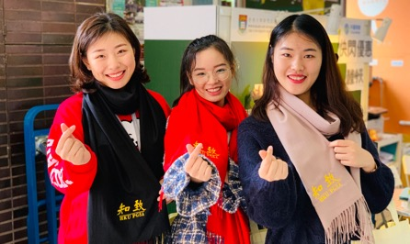
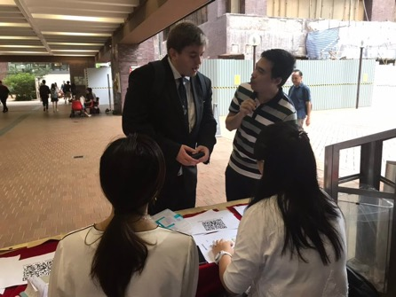
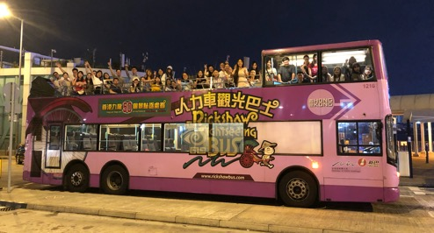
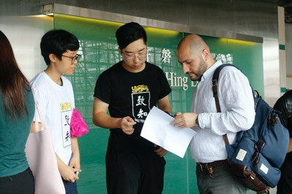
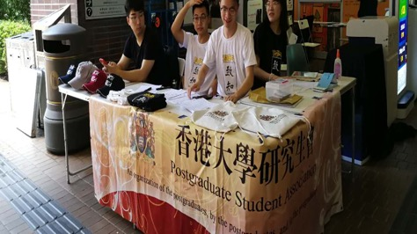
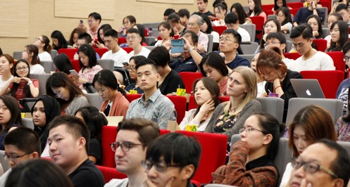
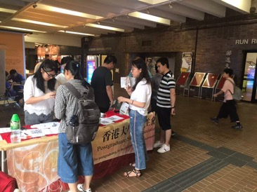
Orientation & Student Welfare 迎新 與 學生福利
Week of Welcome
Orientation Ceremony
Mega Sales
Bus Tour Hong Kong
Welfare Week
Giftpack Distribution

Slide 16
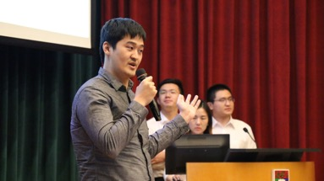
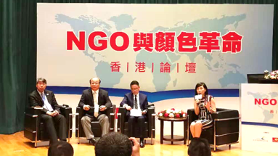

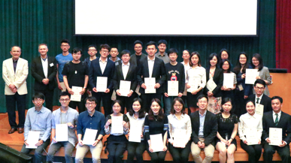
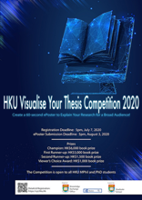

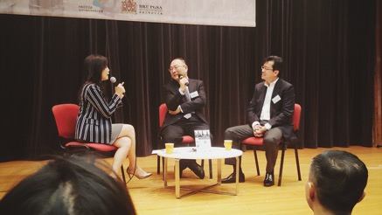
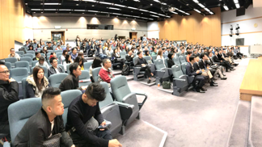
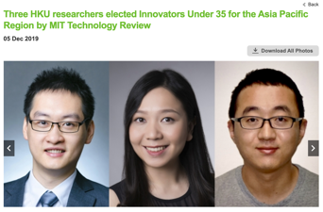
Academic Events 學術活動
Interdisciplinary Research Competition (IRC)
3MT Competition
HKU Visualise Your Thesis Competition 2020
Interview with Innovators Under 35 from HKU selected by MIT
Zhizhi Forum (致知論壇)
BGI Forum (華大基因論壇)
Cell Phone Photographing Lecture

Slide 17




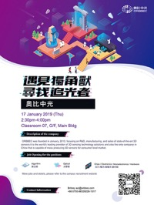


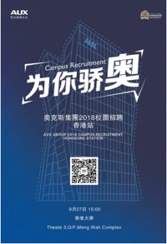

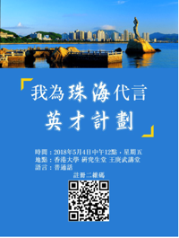



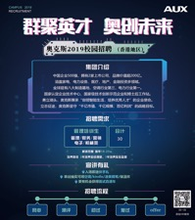


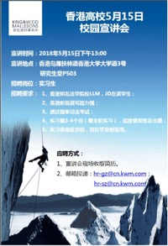


Career Development 求職 與 創新創業
Recruitment talks
Companies
Universities
Job fairs
Job seeking training
Innovation and entrepreneurship
Songshan Lake I.E. Competition
iDendron

Slide 18

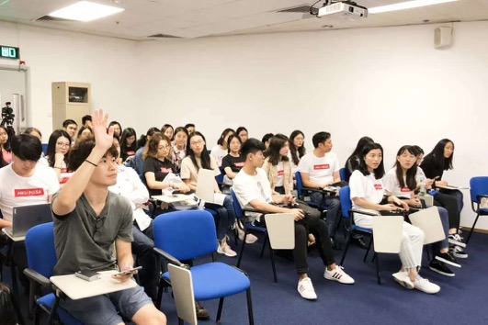
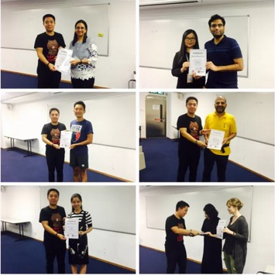
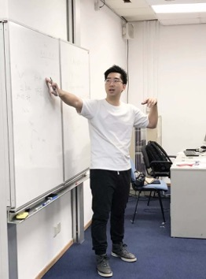

International Student Engagement 服務國際學生
Go Go Mandarin
International Student Festival

Slide 19





External Liaison 外聯事務
Participation
Tsinghua University, Peking University, CUHK, HKUST, CityU HK, PolyU HK, Baptist University, Shenzhen University, The University of Macau, Macau UST, CityU Macau, Jinan University, Hehai University, etc.
Reception
Columbia University, Taiwan University, Fudan University, Huazhong UST, Jilin University, Yangzhou University, CityU HK, etc.
Visiting
National University of Singapore, Nanyang Technology University, Taiwan University, etc.

Slide 20





Social Responsibility 社會公益服務
Food Angel (惜食堂) volunteering
Sai Wan street cleaning
Pok Fu Lam Village Road Building
Nothing but Nets, Charitable Donation campaign
Cooperateing with the United World Foundation, PGSA scheduled a donation campaign on campus for African Children.
Guideline of Obtaining CuMask+ for PGs

Slide 21





Affiliated Societies 屬會社團
Sport Teams
Basketball Team
Soccer Team
Interest Groups
Arts Society, Robotics Society, Fieldtribe Society, Campus Dining Society
Sub-Student Associations
Civil Engineering Graduate Association,
Faith Group
Vedas Heart and Soul Society

Slide 22



Team Building 執委團建

Slide 23









Singles’ Day Party 單身派對
Christmas Feast 聖誕晚宴

Slide 24










Graduation High Table Dinner 畢業高桌晚宴

Slide 25





Tsinghua SEmotion A Cappella Concert 清華大學人聲合唱音樂會

Slide 26
Wish You A Bright Future
Notes:
14:45 - 14:50
26

